Slide 1
INTERVIEW MANAGEMENT SYSTEM
TEAM ALPHA

Slide 2
Team Members
Aravindhan Ra
Darshana A
Deepika S
Gokul P
Kumaresh K S
Prithvi Raj P
Remuki S
Sheik Fareeth H
Vinoth J
Project Duration in Days : 82 days

Slide 3
About this application
The main purpose of this IMS is to schedule drives in an organized manner and to collect the availabilities of the interviewers.
This system is very helpful to measure the performance of each interviewer themselves.
Management person is the one who can view the performance of the interviewers of his/her department. So, this an extra privilege given to the users.
Admin is another user, who has the permission to verify the register user and allow the user to access the website and to manage the Departments, Locations, Projects and Roles of our company.

Slide 4
EXISTING CHALLENGES
It is very tough to organize a drive and the time wasted for this process is too high.
It is hard to find the availability of an interviewer.
It is hard to measure the performance of each interviewer and increase their responsibilities and ownership towards the organization

Slide 5
Solution and Architecture
It is easy to collect the availability of the interviewers for the drive within a particular interval of time.
It is easy for an interviewer to track their performance.
It is helpful for a Management person to track his/her performance and it will give and overall picture of their department's performance as well.

Slide 6
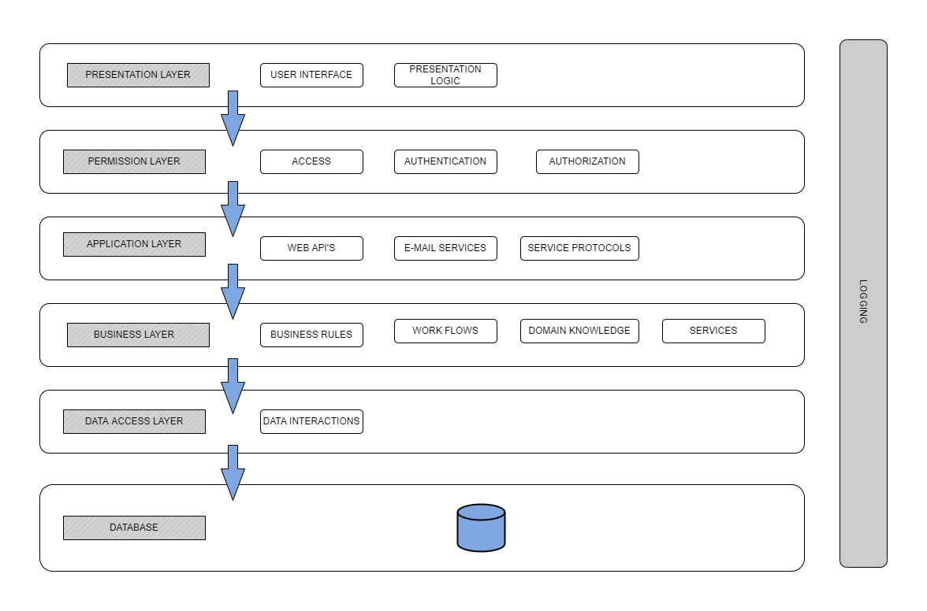

Slide 7
Execution journey
User stories
Functional and Non-Functional Requirements
Wireframe
HTML Template
Angular Components
Web API
Integration
Unit Testing
Set-up Documentation
SonarQube
Linting
Light House
Deployment in IIS
JMeter
High Level Design
Low Level Design
Test Scenarios

Slide 8
Artifacts
Areas | Link
Requirement – User Stories, Wireframes, Data Flow | Project/Requirements/Prototype at master · TeamAlpha01/Project (github.com)
Swagger - API | https://localhost:7072/swagger
Data Model – EAR (Entity Attribute Relationship) | Project/Design/Data Model at master · TeamAlpha01/Project (github.com)
Test Scenarios
Sequence Diagrams | Project/Design/Low Level at master · TeamAlpha01/Project (github.com)
Defect Logs | Project/Revised Plan.xlsx at master · TeamAlpha01/Project (github.com)
Code Quality Metrics | Sonar and Lint reports
Setup Manual | Project/Document at master · TeamAlpha01/Project (github.com)

Slide 9
Technologies & Tools used
Asp Dotnet Core 6.0
Angular 13
Visual Studio Code
Node js
Angular
SonarQube
Jdk
JMeter

Slide 10
DEMO
Angular : http://172.24.217.145/IMS-Angular/
API :

Slide 11
Lessons Learned
Understand the system end to end.
Collect the requirements properly.
Think as an end user while designing a system.
Don't forget to address Non – Functional Requirements.
Learned to work as a team with responsibilities.
Always keep a backup of our work.
To respect others time in our team.
To avoid conflicts and to resolve conflicts.
To value the customer inputs and make use of it.
To identify the bugs earlier.

Slide 12
Lessons Learned Contd..
Never assume.
Learned how to use testing tools.
Learned to track time with honest timesheet.
Don't hesitate to ask questions.
Team meetings are always important to track the works.
Brainstorming is very important to share ideas.
Always update MOM to track the meeting updates.
"Timesheet is the mirror for your career growth"

Slide 13
THANK YOU - Team alpha

